Slide 1
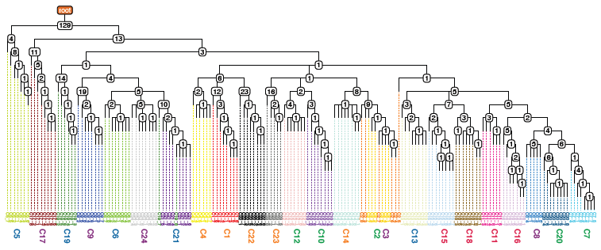
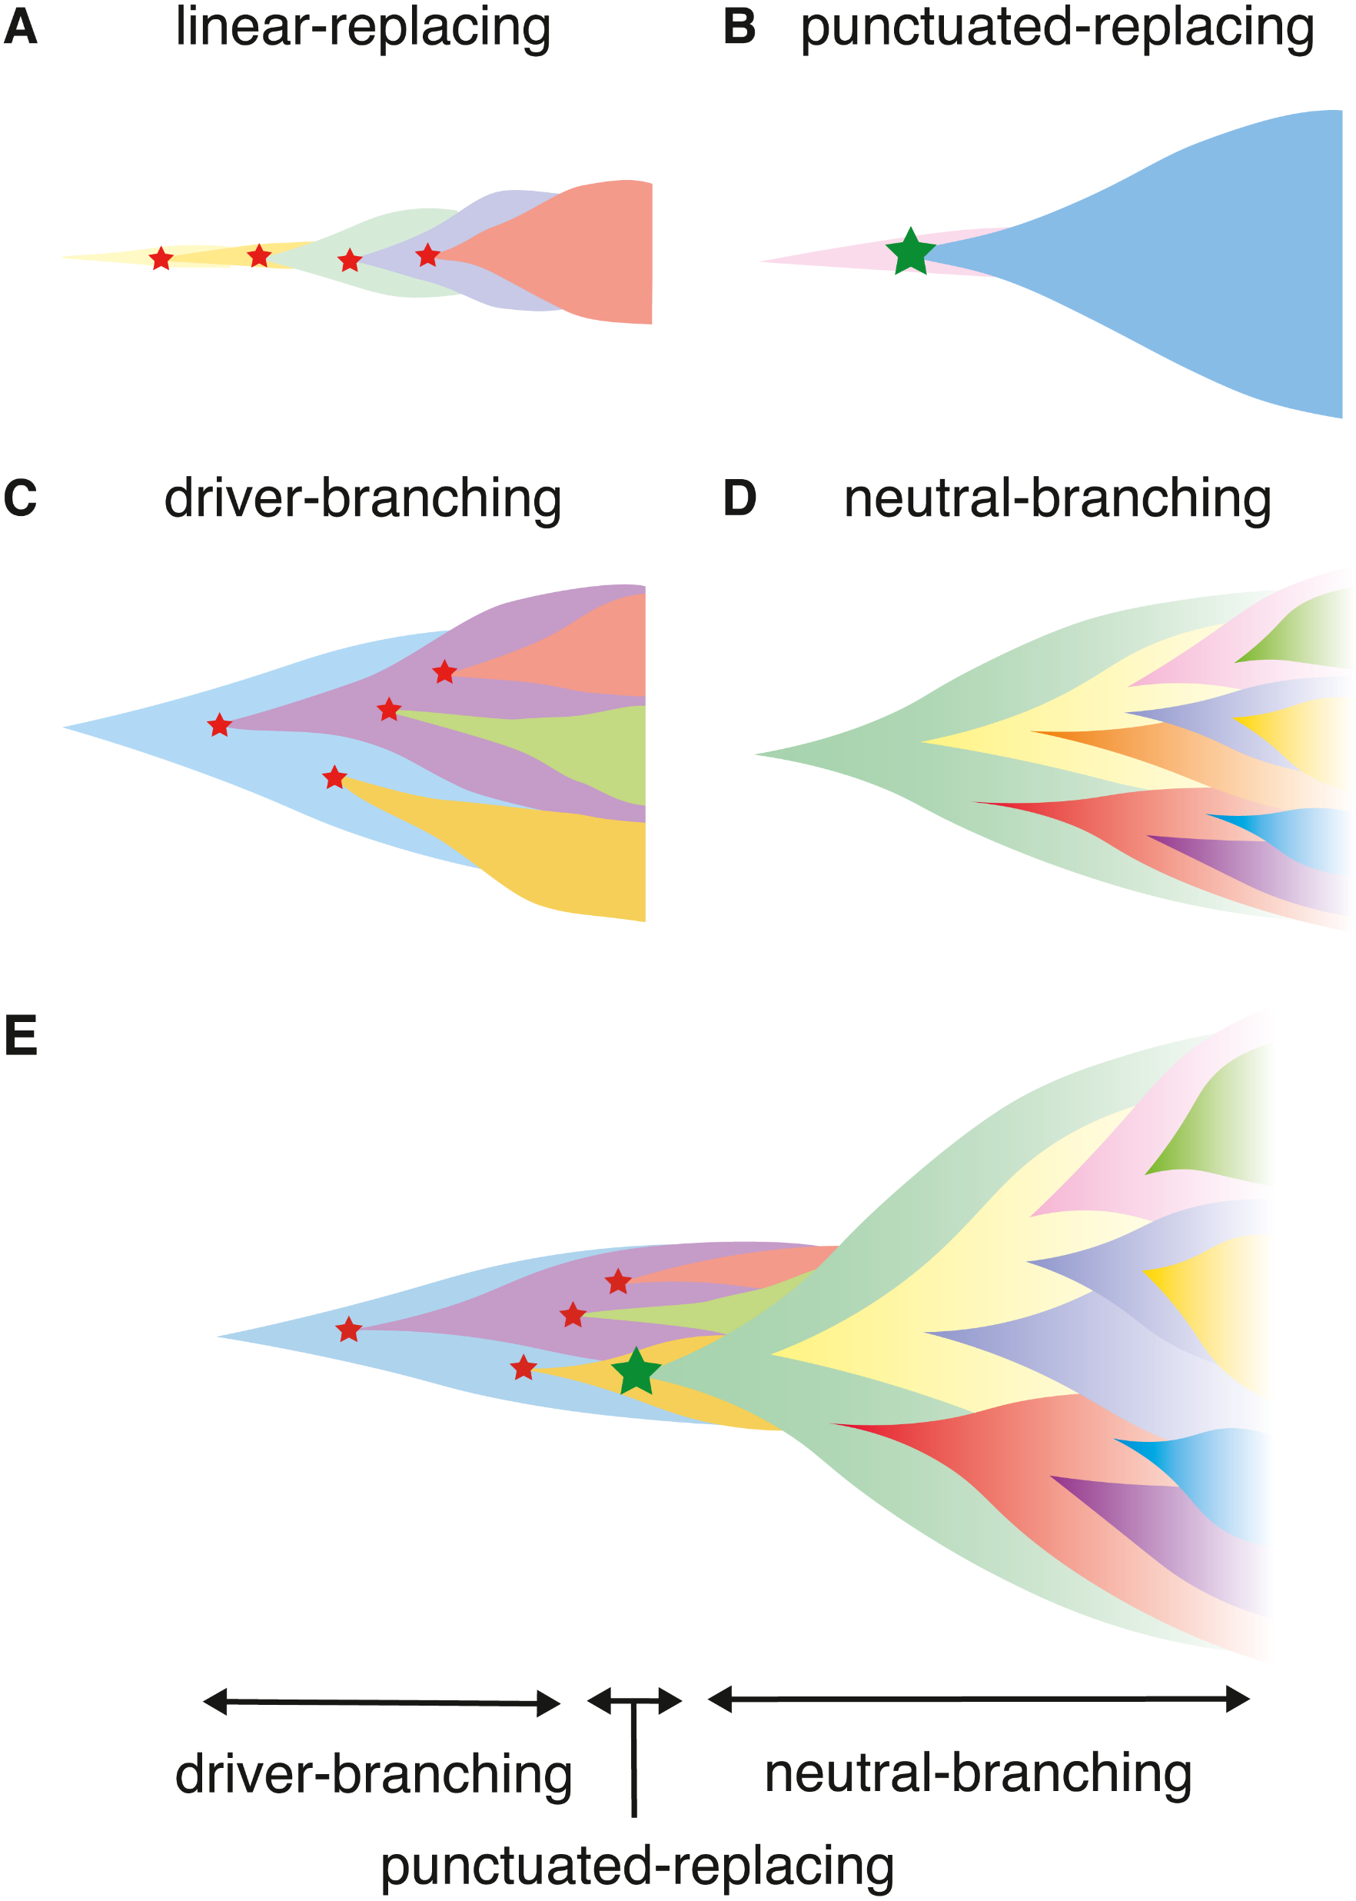
Tools for Measuring Molecular (Tumor) Evolution
Suraj Joshi
suraj.joshi@nih.gov

Slide 2
Disclaimers (1/1)
These methods are generalizable to
developmental biology,
species evolution,
any disease that undergoes ‘omic changes
But I’ll focus on cancer

Slide 3
Molecular (Tumor) Evolution: What? (1/2)
Cancer is an evolutionary disease.
mutation + selection
Normal cells -----------------------> Tumor cells
Tumor-associated mutations are usually somatic – they occur after conception; not inherited

Slide 4
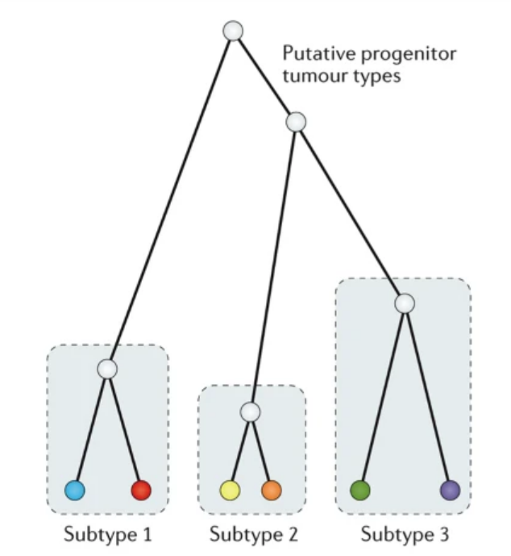
Molecular (Tumor) Evolution: What? (2/2)
Order of mutations is visualized via phylogenies
Almost always assume genetically identical normal cells are common ancestor
Tumors tend to evolve as heterogeneous subtypes or clones

Slide 5
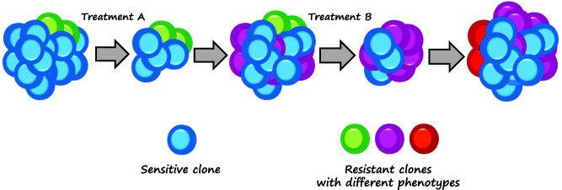
Molecular (Tumor) Evolution: Why? (1/1)
Tumors can adapt to therapy.
Immunotherapy: acquired resistance via altered expression & mutation
Gene therapy: “hidden” clones spread after dominant clone killed

Slide 6
Molecular (Tumor) Evolution: How? (1/6)
Depends on
Sequencing Paradigm (bulk, single-cell, single-molecule)
‘Omics Paradigm (genome, exome, transcriptome, …)
Your specific question
Do you want a phylogeny of mutational clones?
Do you want to cluster mutations into clones?
Do you want to look at specific driver genes?

Slide 7
Molecular (Tumor) Evolution: How? (1/6)
Depends on
Sequencing Paradigm (bulk, single-cell, single-molecule)
‘Omics Paradigm (genome, exome, transcriptome, …)
Your specific question
Do you want a phylogeny of mutational clones?
Do you want to cluster mutations into clones?
Do you want to look at specific driver genes?

Slide 8
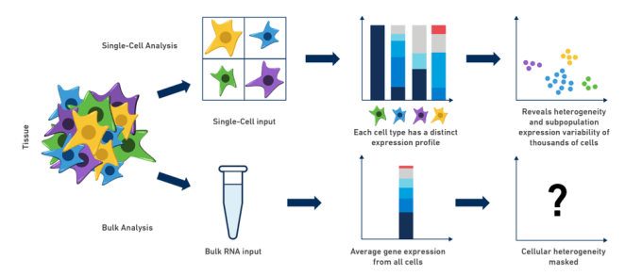
Molecular (Tumor) Evolution: How? (2/6)
Let’s start with Bulk Sequencing

Slide 9
Molecular (Tumor) Evolution: How? (2/6)
Let’s start with Bulk Sequencing

Slide 10
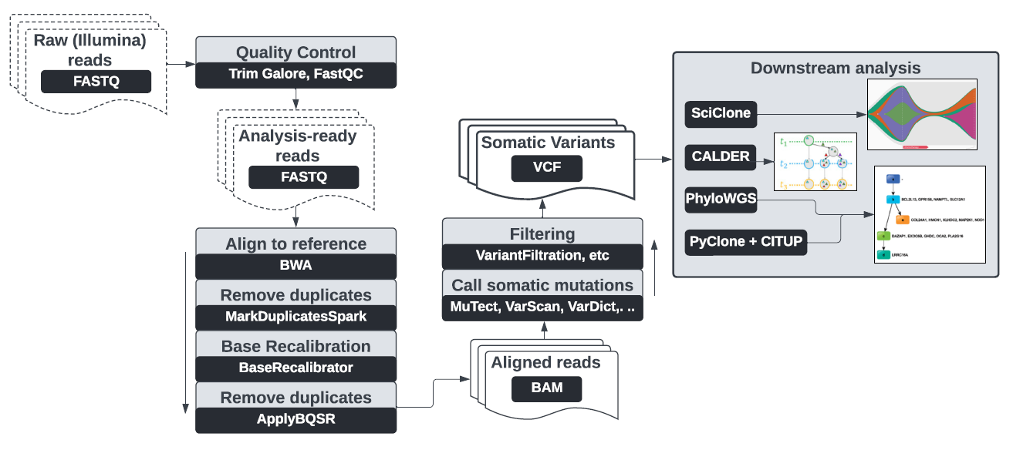
Molecular (Tumor) Evolution: How? (3/6)

Slide 11
Molecular (Tumor) Evolution: How? (3/6)

Slide 12
Molecular (Tumor) Evolution: How? (4/6)
(Cleaned) Somatic variant data looks like this:
chrom | pos | ref | alt | ref reads | var reads
1 | 1010151 | A | T | 100 | 20
2 | 112203 | G | CCAT | 50 | 40

Slide 13
Molecular (Tumor) Evolution: How? (4/6)
(Cleaned) Somatic variant data looks like this:
chrom | pos | ref | alt | ref reads | var reads
1 | 1010151 | A | T | 100 | 20
2 | 112203 | G | CCAT | 50 | 40
SNV
INDEL

Slide 14
Molecular (Tumor) Evolution: How? (4/6)
(Cleaned) Somatic variant data looks like this:
Common metric: variant allele frequency (VAF)
VAF = var reads / (var reads + ref reads)
surrogate for “prevalence” of variant
chrom | pos | ref | alt | ref reads | var reads
1 | 1010151 | A | T | 100 | 20
2 | 1122030 | G | CCAT | 50 | 40

Slide 15
Molecular (Tumor) Evolution: How? (5/6)
Cluster by VAF
Create phylogeny of clusters
chrom2 G->CCAT
…
…
chrom1 A->T
…
Common rules
VAF never increases down the tree
sum of VAF of children less than VAF of parent
“trunk” should have ubiquitous mutations
chrom2
G->CCAT
…
root
chrom1 A->T
…
…

Slide 16
Molecular (Tumor) Evolution: How? (6/6)
Plotting
Python
Graphviz
NetworkX
ETE3
R
ggtree
phytools

Slide 17
Molecular (Tumor) Evolution: How? (6.5/6)
Formats
Most common: Newick
1(2, 3);
1
2
3

Slide 18
Demos!
Not real data

